Slide 1



Bharati Vidyapeeth (Deemed To be) University
College of Engineering
DEPARTMENT OF COMPUTER ENGINEERING
Zensar Technologies
In Plant Training
Pune 2019
BY-
NAME: Saksham Gupta
ROLL NO: 16
PRN: 1614110140
Exam No: 1914381007

Slide 2
overview
Java
Advanced Java
Junit
UI design
Project:
DREAM SOCCER LEAGUE

Slide 3
Java
Project Development Phases
Getters and setters
Java Virtual Machine
Constructors
Java Beans
Abstract keyword,method,class
Interface
Project Creation

Slide 4
In Plant Training
In Plant Training for students to enrich their knowledge on Software ,Hardware and Networking.
Provide them exposure in real time Industry Knowledge.
Trainers are delivering a relevant and guided learning skill that combines Lecture and practice to deliver what you need to know about a product or technology.

Slide 5
Java
Exception Handling
Assertion
Inner Classes
Constructors
Multi Threading
Synchronization
File Systems
RDBMS

Slide 6
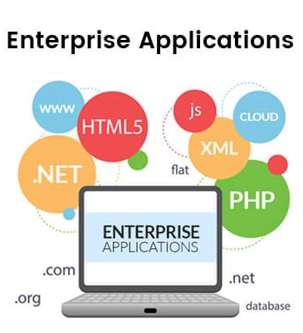
Advanced Java
Client Server Architecture
HTTP
Servlets
Life Cycle Methods
web.XML
Servlet Collaboration
Listeners
Session Tracking

Slide 7
Advanced Java
MVC
Filters
Interface
Grammar of JSP
Scriplets
JSP Centric MVC
Listeners
Session Tracking

Slide 8
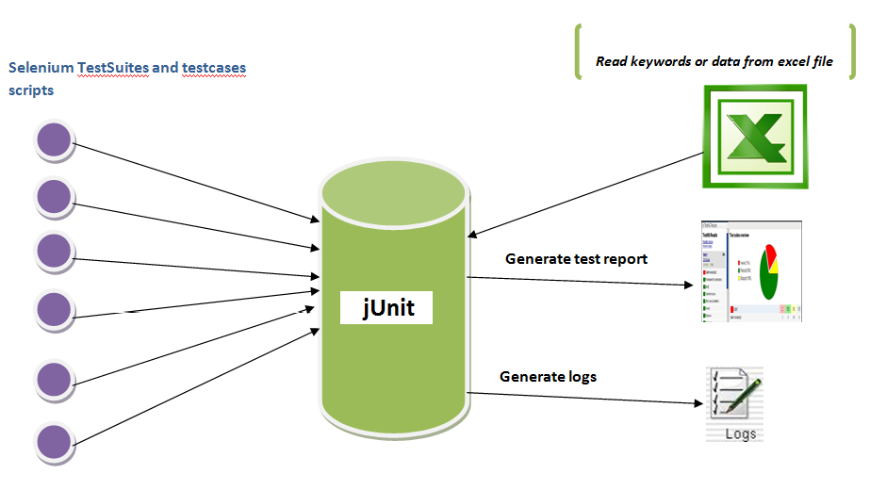

Slide 9
UI design
Basics of HTML
Static Web Page
Website
Basics of CSS
Types of CSS
website
Javascript
Implementation of JS in form

Slide 10
Dream Soccer League(DSL)
JAVA BASED WEB APPLICATION DESIGNED DEVELOPED, DURING THE SUMMER INTERNSHIP
THIS PROJECT CONSTITUTES THREE MODULES:
1. ADMIN MODULE
2. TEAM MODULE
3. USER MODULE

Slide 11
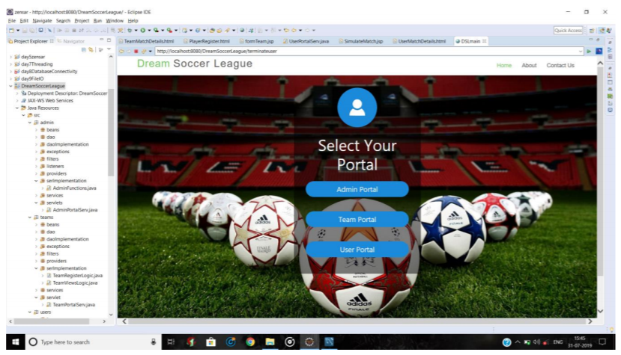
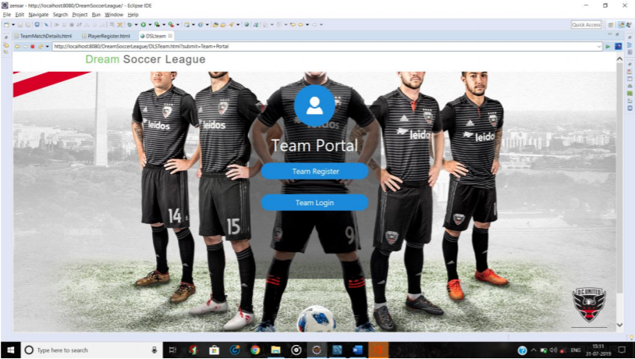
Project Implementation

Slide 12
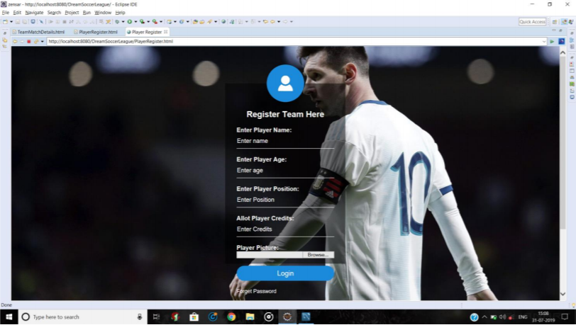
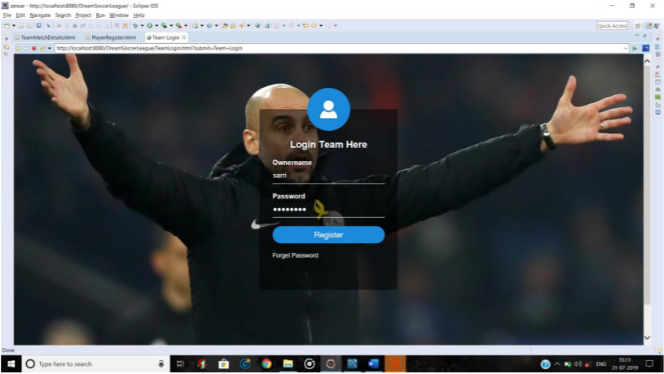
Project Implementation

Slide 13
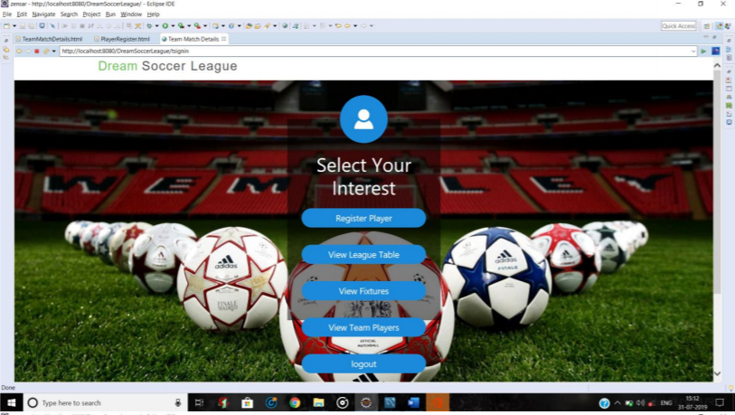
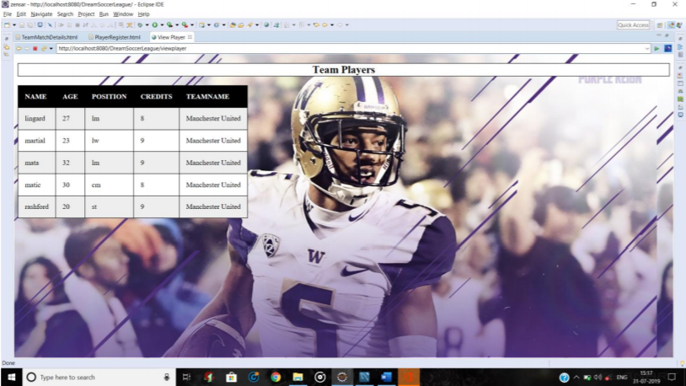
Project Implementation

Slide 14
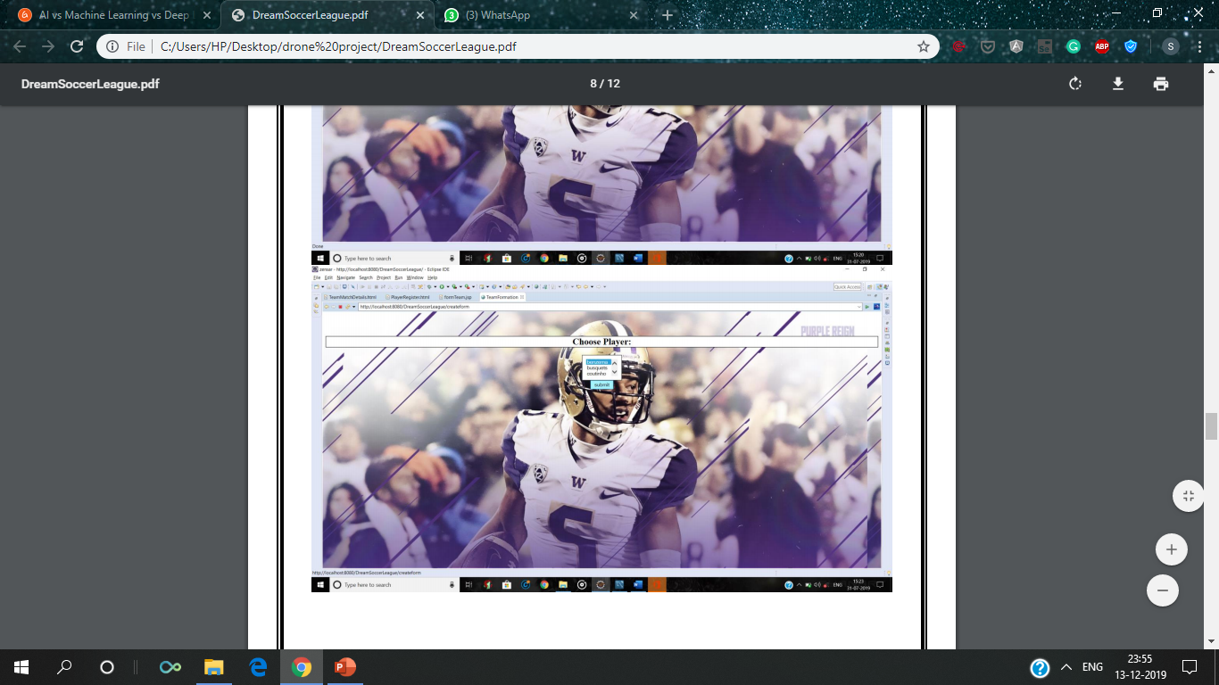
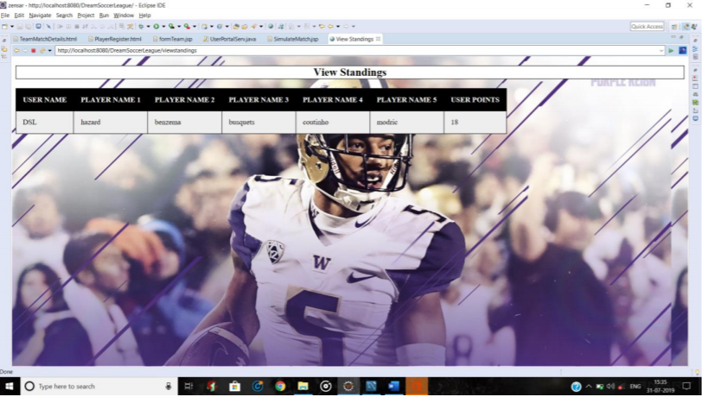
Project Implementation

Slide 15
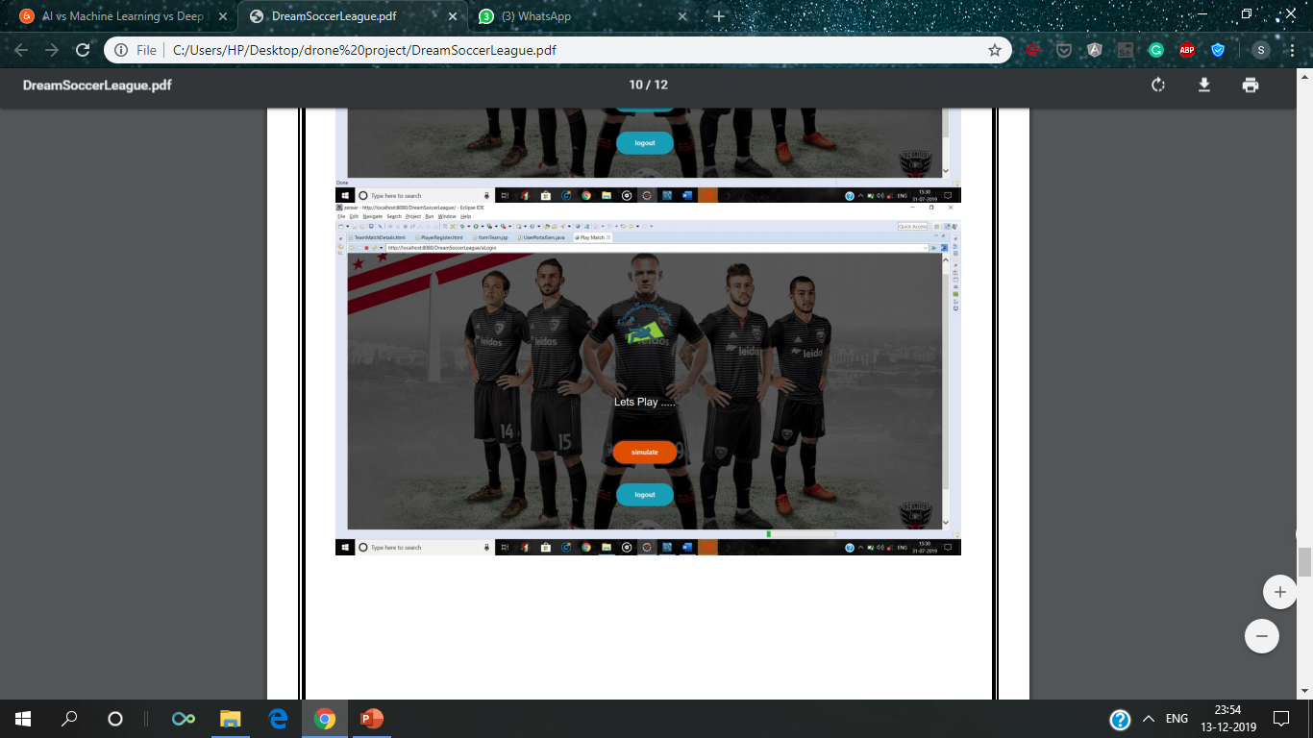
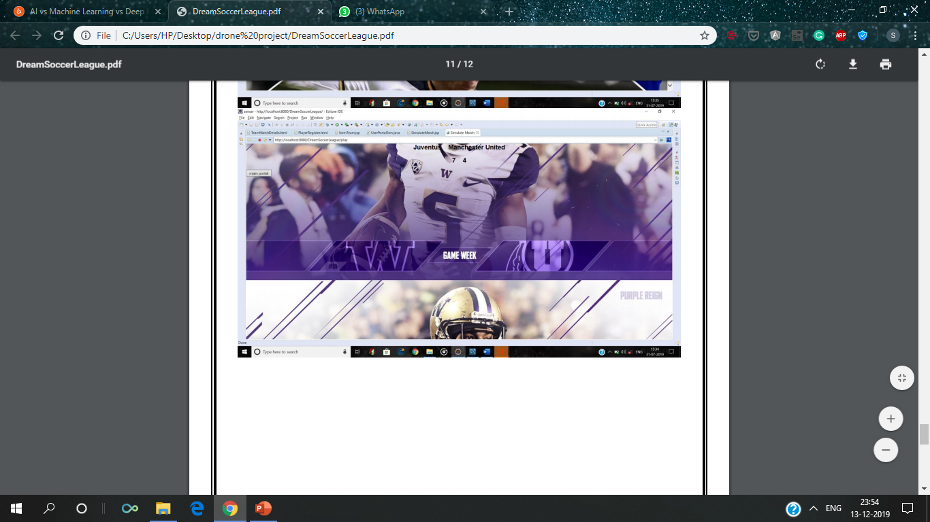
Project Implementation

Slide 16
Responsibility in Project
Business logic Team Module
Business logic User Module
Servlet
JSP
Database Implementation

Slide 17

Conclusion
Industrial Training program in Zensar Technologies had given opportunities to us to prepare ourselves as future IT experts.
It also trained us on soft skills and other aspects to improve our personality.
It also helped us to improve our hands on experience and exposure to corporate development.

Slide 18
THANK YOU

